Slide 1

PC Critical Accessory Items
For HCL Kiosk and Site Service technicians
June 2020

Slide 2

Objectives
This document provides PC Accessory Critical Stock training to all HCL Site Support members, both EC Kiosk and Site Services and may serve as a reference guide for PG Site Leadership
Principles
With the roll out of the new IT Asset Management toolkit and guiding principles, we will use better control measures of deploying accessory items provided by P&G to HCL for the purpose of distribution to the customer base.
HCL Site Services should support P&G with a standard global process
Non-critical items should be ordered by the customer through Coupa. Critical accessories items can be loaned or purchased from Kiosks and Site Service teams at plant and tech centers.

Slide 3
Critical Stock Asset Lifecycle
Assets are pulled from stock and replenished in bulk
Asset provided as a loan or purchase
Customer is Cross Charged or item is returned
Asset replacement is reordered in bulk order.
Asset replacement arrives and is added to stock.
Asset in stock
Notes:
Remove blue line

Slide 4
Initial Set Up and Inventory
Each site to work with the P&G site leader or IT/OT to determine initial stock.
Inventory should be ordered via a SNOW ticket and an order placed on behalf of the P&G site leader in Coupa.
Inventory should be counted weekly.
Inventory reconciliation should be performed monthly by comparing physical inventory and any SNOW tickets waiting to be delivered.
Reordering should occur on a regularly agreed upon timeline. Usually monthly.
Cross Charge reports can be generated to send out automatically. See reporting section.

Slide 5
What Accessories Are Included As Critical Stock?
The intent of critical spares is to help a customer advance to an operational level until an item can procured through Coupa (typically 2-3 business days). For this reason, inventory should be kept to a few basic items such as:
Laptop power supplies
Mice (wired or wireless)
Keyboards (wired or wireless)
Wired headsets
Network cables
Security cables

Slide 6
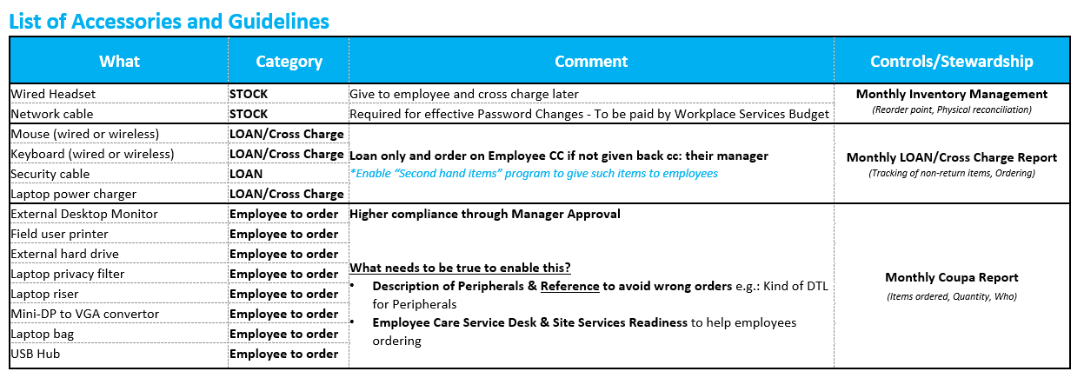
IT Accessory process (kiosk and non-kiosk locations)
Effective immediately HCL Teams should start using the following IT Accessories Process for both Kiosk and Non-Kiosk locations.
Sites should limit site stock of Accessories to the Critical Spares listed below. (ie; stock and loan)
* Plant locations may opt to add additional accessories with approval from the IT/OT Site Leader

Slide 7
Ways to provide critical spares
Critical spares can be provided to the customer in 3 different ways:
Loan - This is an IT accessory in which the customer will return. Ex: Mouse, Keyboard, Security Cable, Laptop Power Supply. A loan should be returned to the Site Team or Kiosk. The ideal time line is within 5 business days, however exceptions can be made on the timing. If the customer fails to return the loaned item, the status will be changed to purchase before the ticket is closed.
Purchase - This is an IT accessory in which the customer wants to purchase for themselves. Ex: Headset or LAN/Network Cable. Many sites will cross charge this expense against the customer’s cost center.
Used - This is an IT accessory returned by another customer for the purpose of IT Asset disposal, which is repurposed for use. An example would be a mouse, monitor, or power supply that are no longer needed but still fit for service. All used accessories passed repurposed must have a ticket associated with it. Used accessories will not be cross charged to the customer and no expense is incurred.

Slide 8
How to track the accessories
When an item is provided to the customer, we must track it through a ticket in the Service Catalog.
This ticket is intended to be entered by HCL Site Services or Employee Care Kiosk agents as the accessory is provided.
Stock replenishment orders and Cross Charging reports are reported based on information provided in the SNOW ticket.
A link to the form can be found here (LINK)

Slide 9
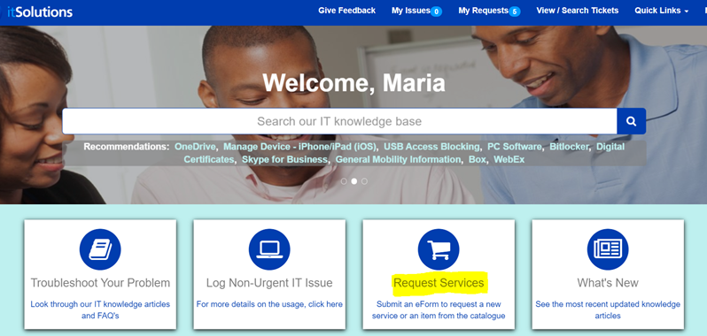
IT Accessory process
IT Accessory eform is located out on ITSolutions:
1.) Request Services

Slide 10
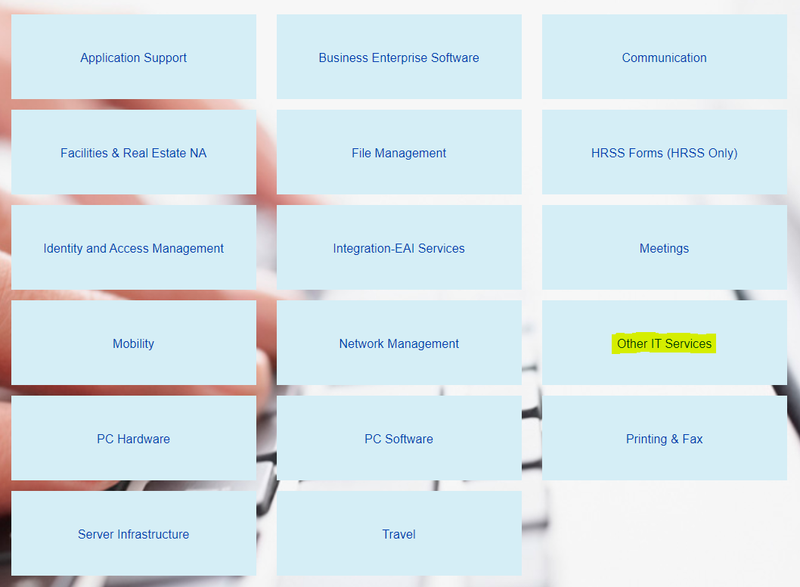
IT Accessory process
2.) Other IT Services

Slide 11
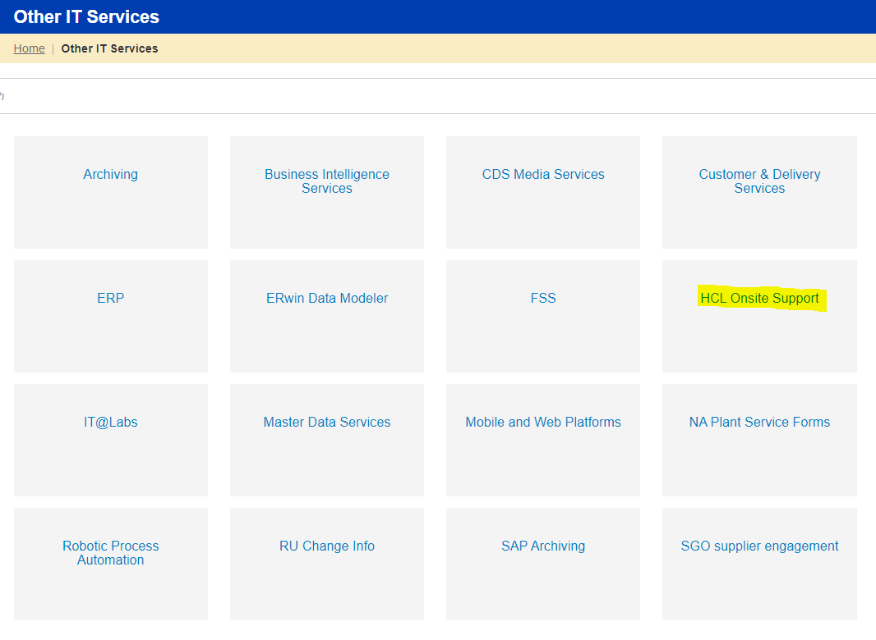
IT Accessory process
3.) HCL Onsite Support

Slide 12
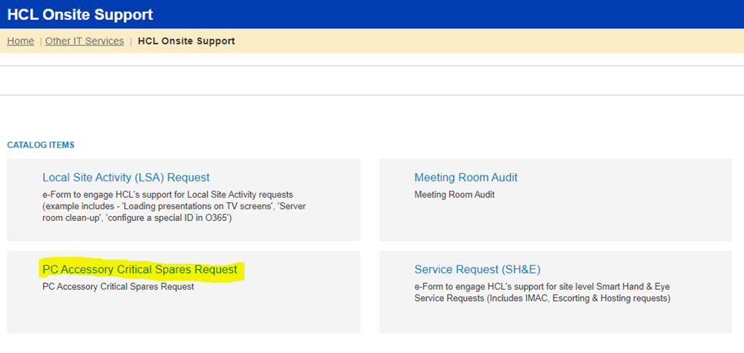
IT Accessory process
4.) PC Accessory Critical Spares Request

Slide 13
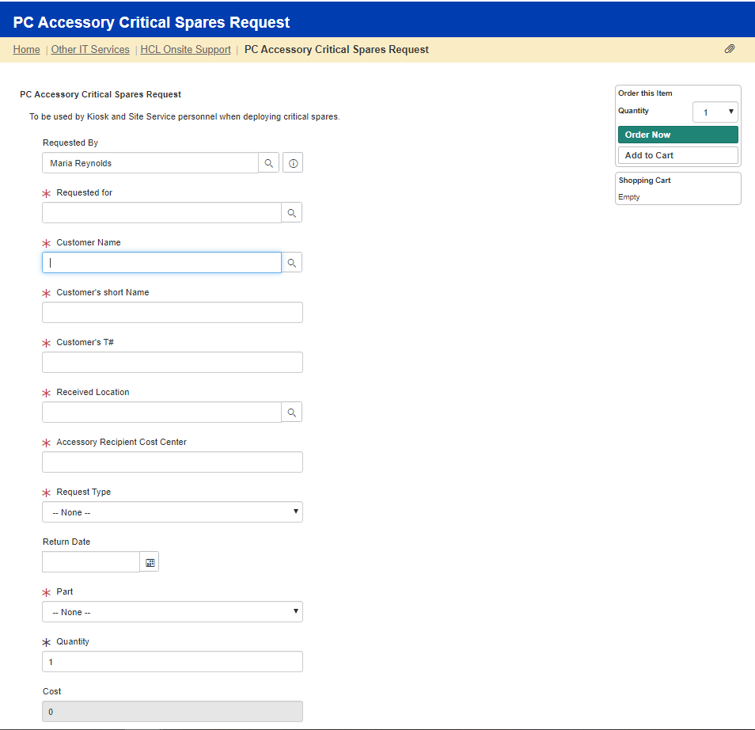
IT Accessory process
Requested By: The technician filling out the eform.
Requested for: Can be the same or different from the customer name.
Ex: Admin getting an accessory for the manager. Search using
first name, last name.
Customer Name: Who the accessory order is for. Search using first name, last name.
Customer’s Short Name: Will autofill based on customers name.
Customer’s T#: Will autofill based on customers name.
Received Location: Location that the part is picked up from.
Can be different from the user’s home location.
Accessory Recipient Cost Center: Will autofill based on customers name.

Slide 14
IT Accessory process
Request Type:
Loan: This is an IT accessory in which the customer will return.
Ex: Mouse, Keyboard, Security Cable, Laptop Power Supply
Purchase: This is an IT accessory in which the customer wants to purchase for themselves. Ex: Headset or LAN/Network Cable
Used: This is an IT accessory returned by another customer for the purpose of IT Asset disposal, which is repurposed for another customer. An example would be a mouse, monitor, or power supply that are no longer needed but still fit for service. HCL will be responsible to clean up accessory to give out as a used accessory.
Return Date: Only needs to be filled out for a “Loan” Accessory.
Loan timeframe = 5 business days unless customer requests a
longer need for the item.
Part#: Choose description from the drop down field. Part number will autofill in the RITM ticket number.
Quantity: Fill in quantity customer is requesting.
Cost: Will autofill in the eform based on predetermined pricing with vendors.
Once complete = Order Now
If the customer needs more than qty 1, do not update in this field, leave as “1”
If the customer needs more than qty 1, update in this field

Slide 15
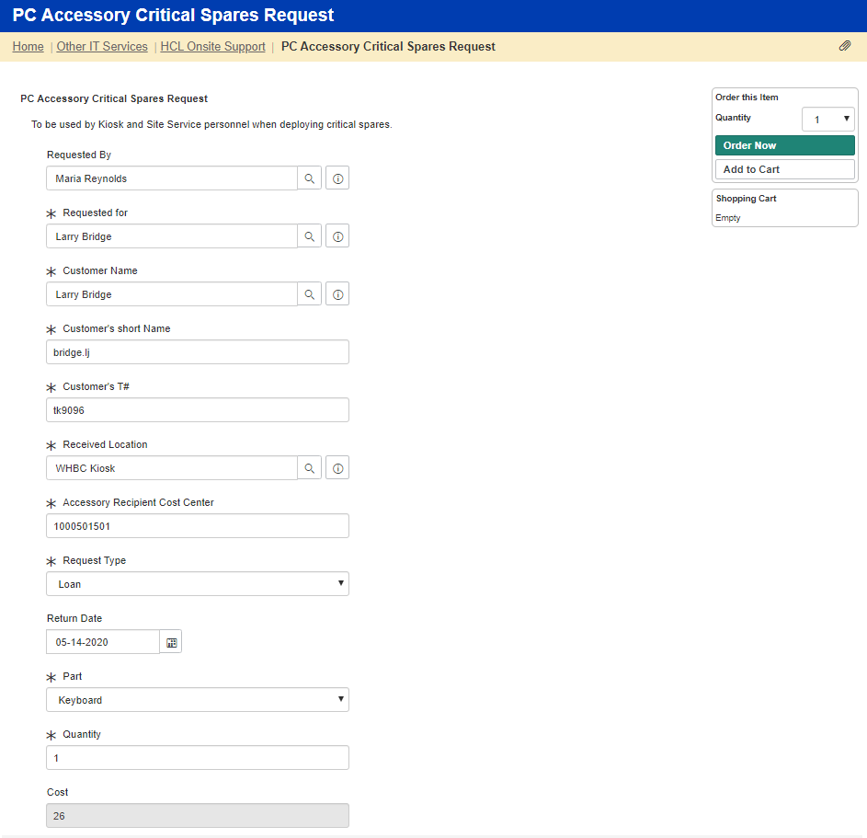
IT Accessory process
Example of a “Loan” accessory:

Slide 16
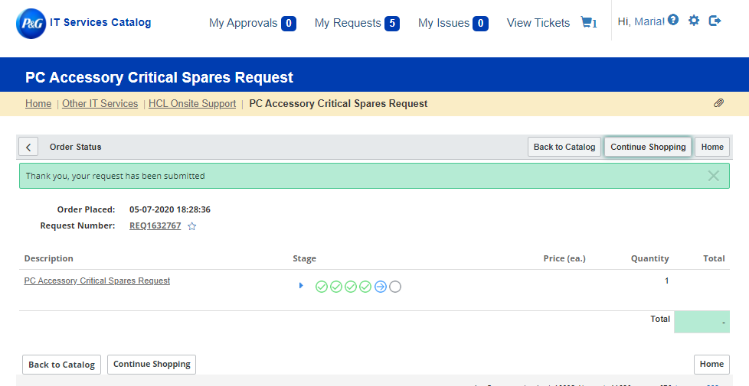
IT Accessory process
Example of a “Loan” accessory:

Slide 17
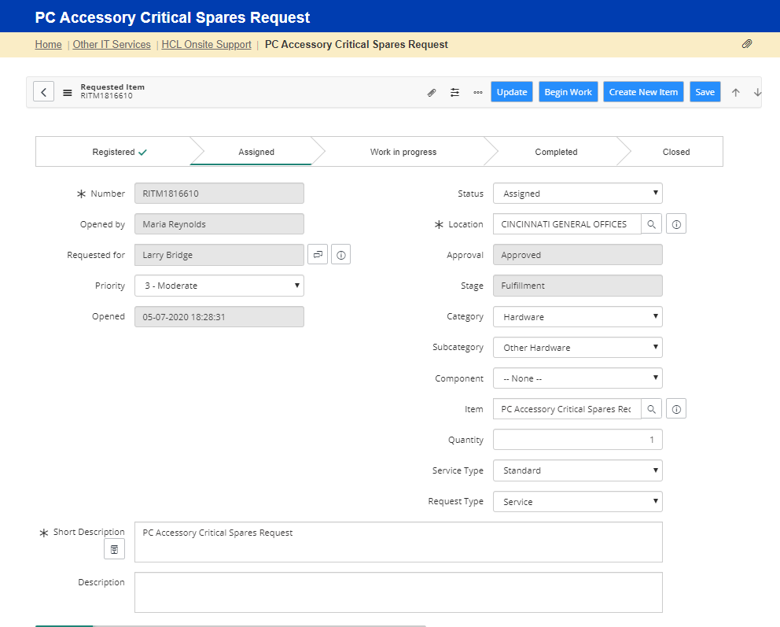
IT Accessory process
Example of a “Loan” accessory:
Status in the ticket will default to Assigned Status, however technician will need to move to Pending status and save the ticket. Hit Begin Work button and move to Pending Status.
Ticket will stay open. Technician will need to go back and close ticket, either when the return date passes or when the customer brings the accessory back.

Slide 18
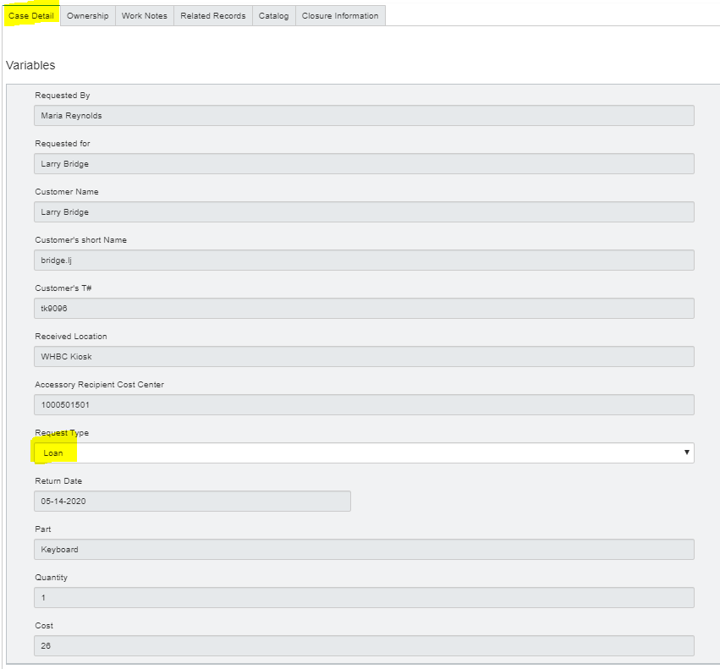
IT Accessory process
Example of a “Loan” accessory:
When the customer returns the accessory, you’ll need to
Leave the Request Type as Loan – under the Case Detail tab.
Enter Resolution Notes: Customer loaned a keyboard and returned it (list date)
If the customer decides to purchase the accessory you will need to change the Request Type to Purchase (drop down field)
Enter Resolution Notes: comment the part# and cost, so when the ticket closes the customer will see the part and cost they are being charged.

Slide 19
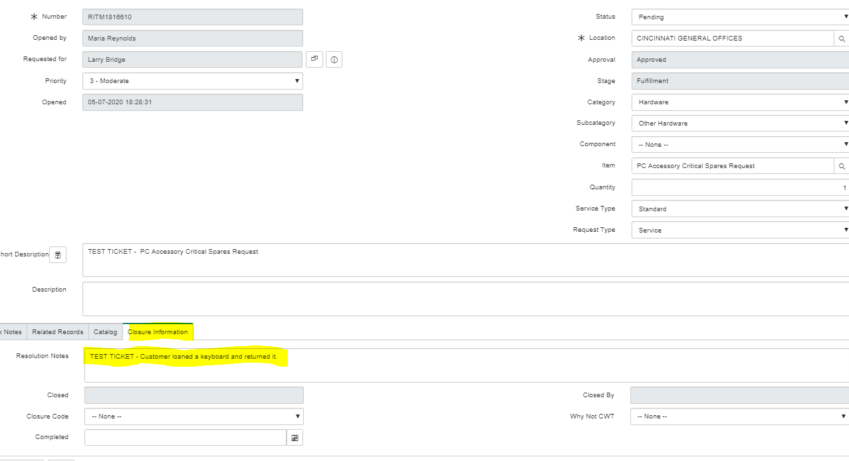
IT Accessory process
Example of a “Loan” accessory:
Closing the ticket.
Please enter Resolution Notes. Keep in mind, customer will see these notes.

Slide 20
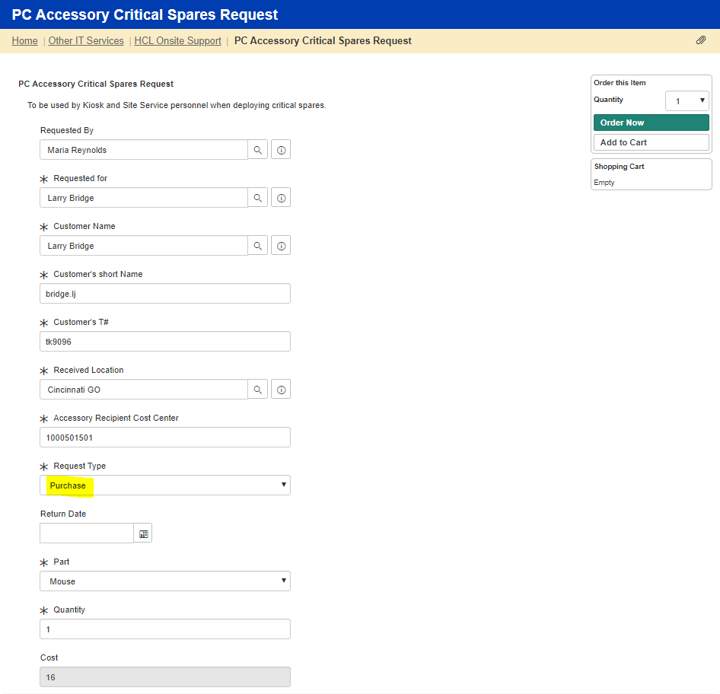
IT Accessory process
Example of “Purchase”
accessory:

Slide 21
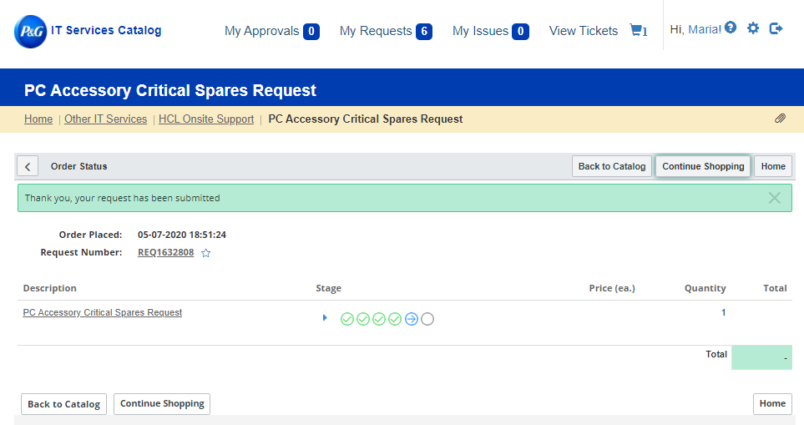
IT Accessory process
Example of a “Purchase” accessory:

Slide 22
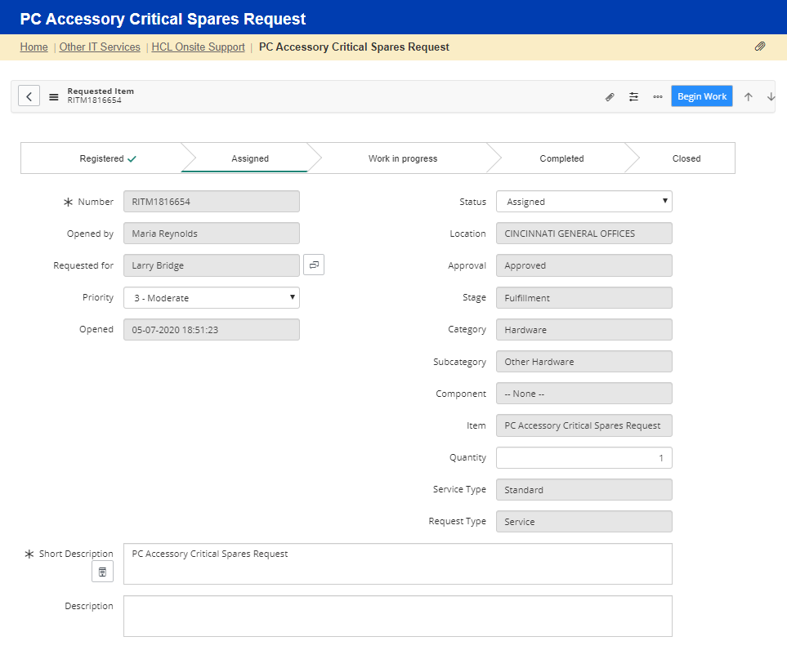
IT Accessory process
Example of a “Purchase” accessory:
In the next round of service enhancements, the Status should move to Closed. Until then we will Hit Begin Work button and then manually move to Closed along with adding Resolution notes.
Please add the part and cost so the customer will have for their records.

Slide 23
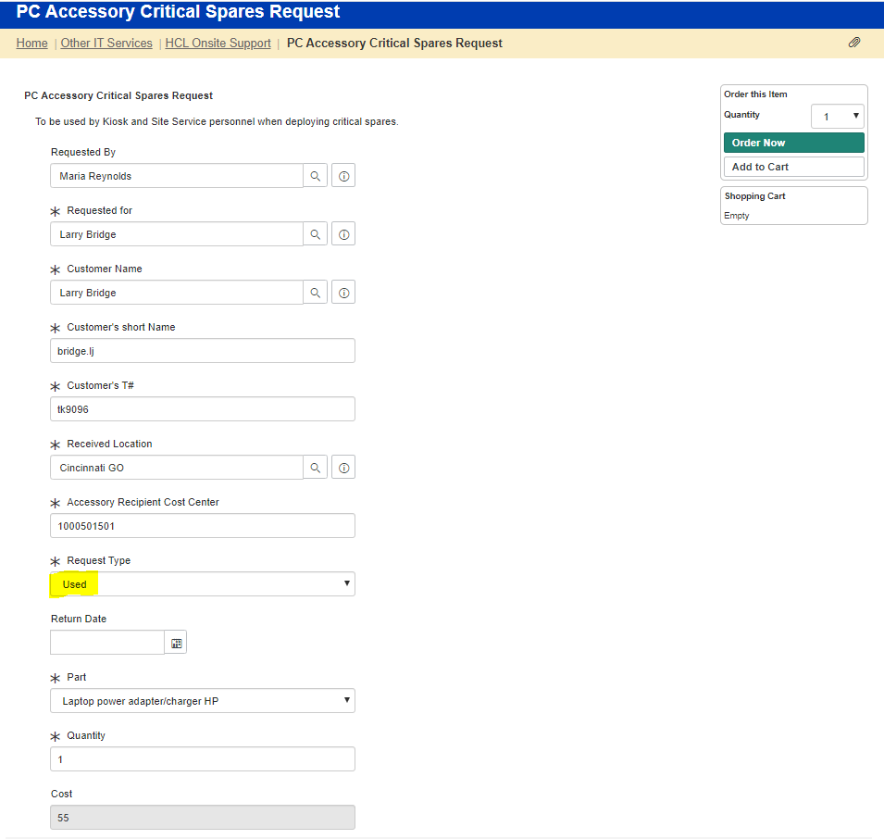
IT Accessory process
Example of a “Used” accessory:

Slide 24
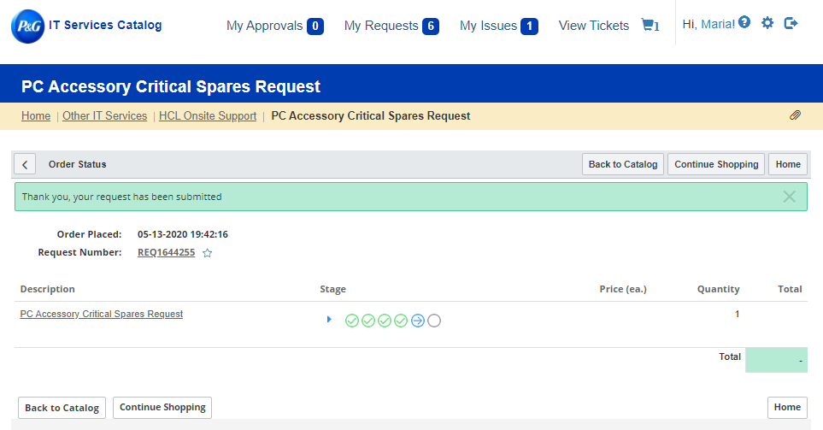
IT Accessory process
Example of a “Used” accessory:

Slide 25
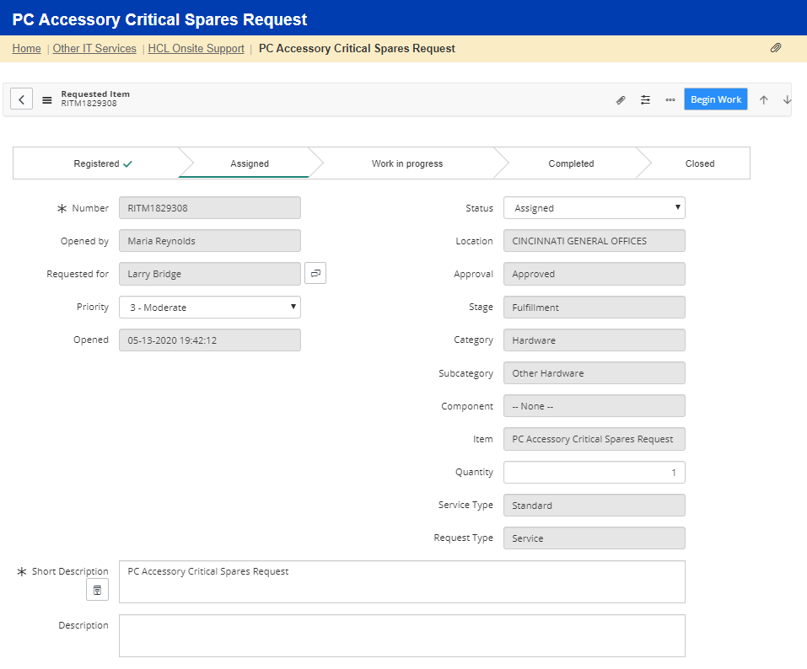
IT Accessory process
Example of a “Used” accessory:
Hit Begin Work button and then manually move to Closed along with adding Resolution notes.
Please add the part and cost so the customer will have for their records.

Slide 26
Reporting
Setting up reports in SNOW
Cross Charging and Stock Replenishment
P&G Site leaders can work with HCL Site Leaders and/or Cluster Managers to set up reporting for cross charges and replenishment or may set them up themselves if preferred.

Slide 27
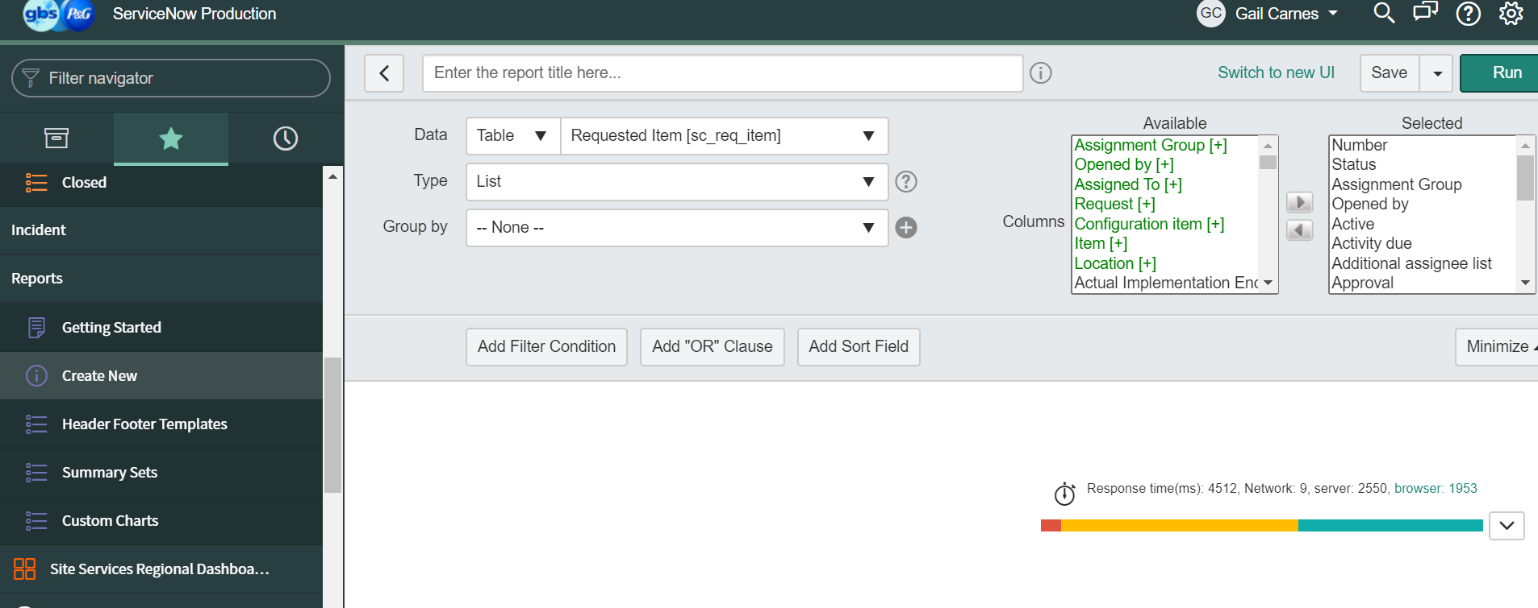
Step 1
Create a new Requested Item Report

Slide 28

Add Filter Conditions to Customize Reports
In Service Now

Slide 29
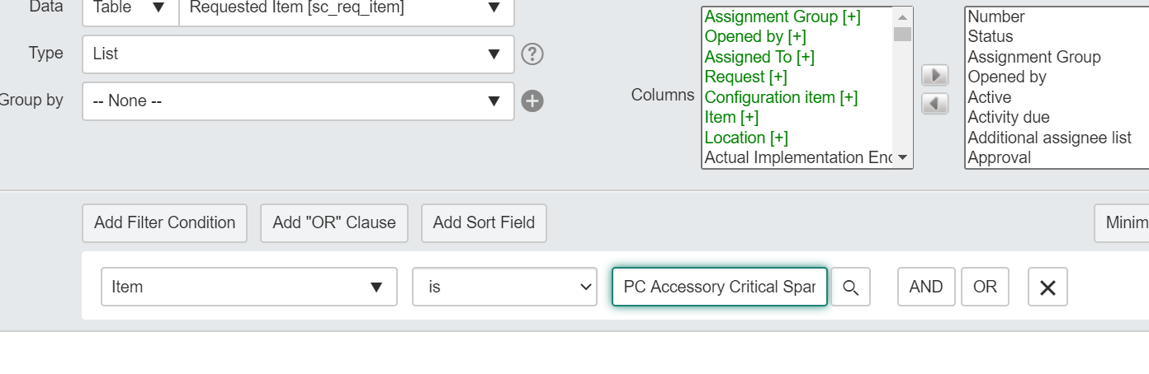
Add Filter Condition “Item”
Add filter Condition
Item Is PC Accessory Critical Spares Request (this is the title of the Catalog Request).

Slide 30
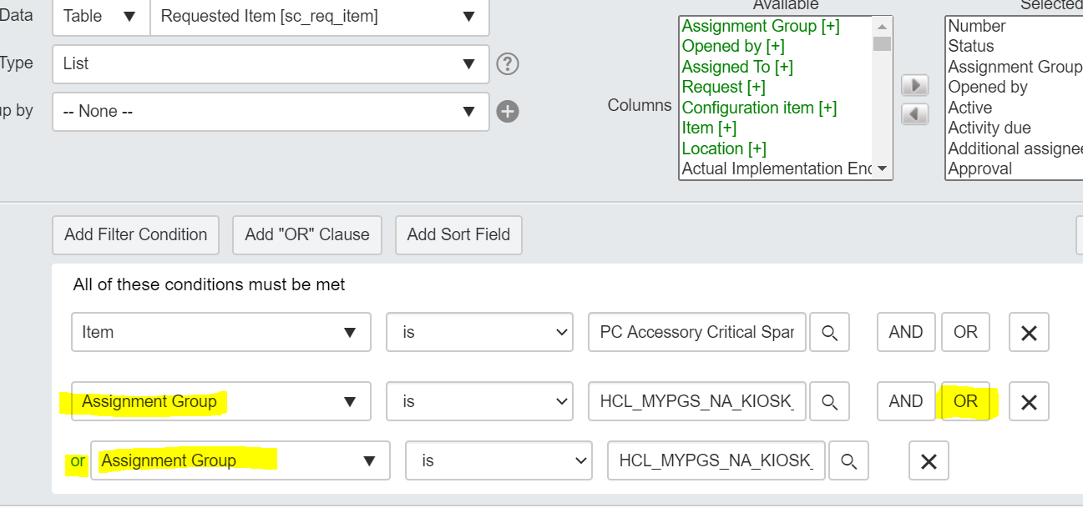
Add Filter Condition “Assignment Group”
Add Filter Condition Assignment Groups and add any assignment groups that which should report cross charging.
Use the OR option to add additional sites.
In the example HCL_MYPGS_NA_KIOSK_CINCINNATI-GO_L1 and HCL_MYPGS_NA_KIOSK_WHBC_L1 are used.

Slide 31
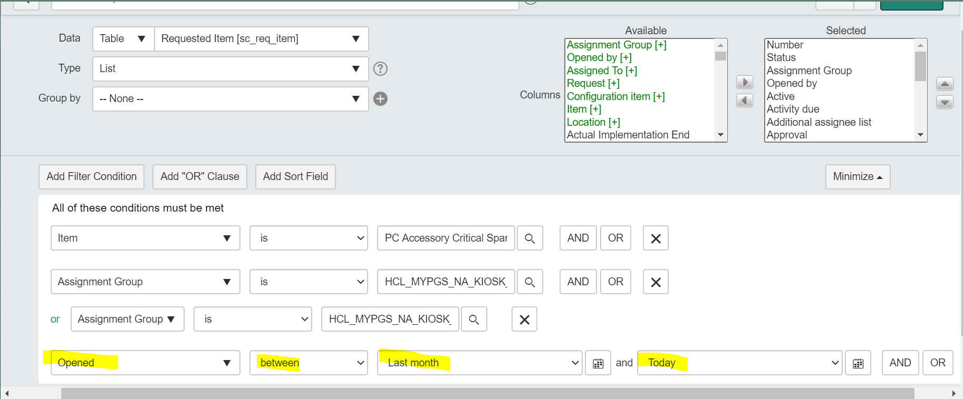
Add Filter Condition “Opened”
Select a date range. Reporting can be customized to send monthly or quarterly. Select Open between, last month and today.

Slide 32

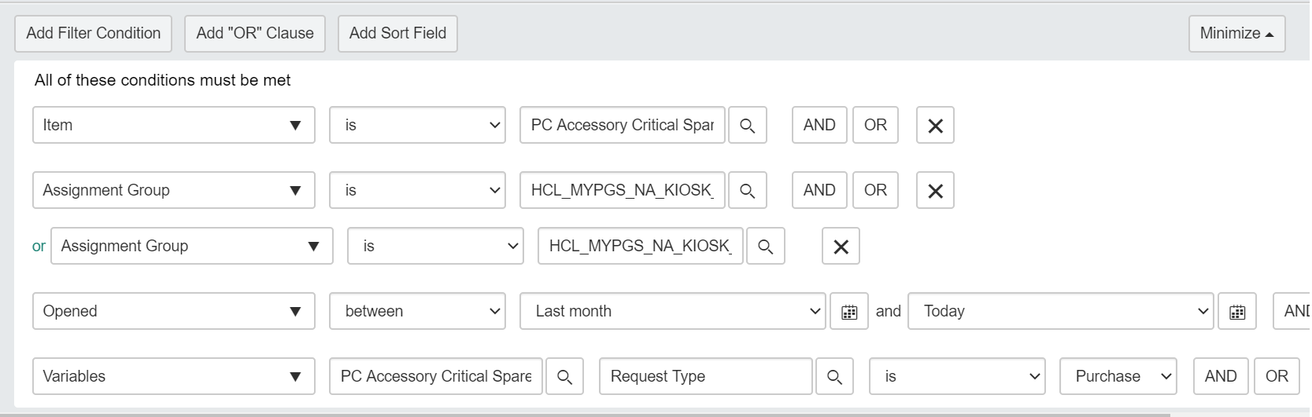
Add Filter Condition “Variable”
Add The filter condition “Variable.”
Select “PC Accessory Critical Spares Request.”
Use “Is” as the condition.
Select “Purchase” from the drop down.
This filter will only return items which have been purchased, and not loaned and returned or used.

Slide 33
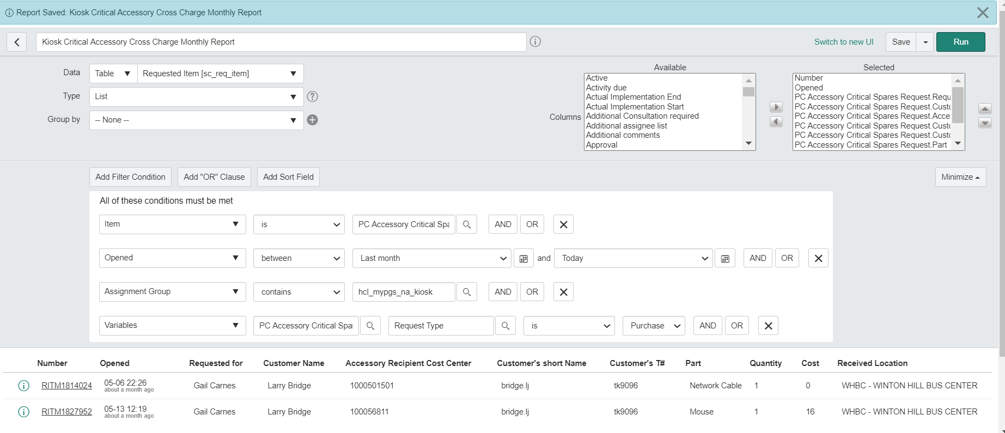
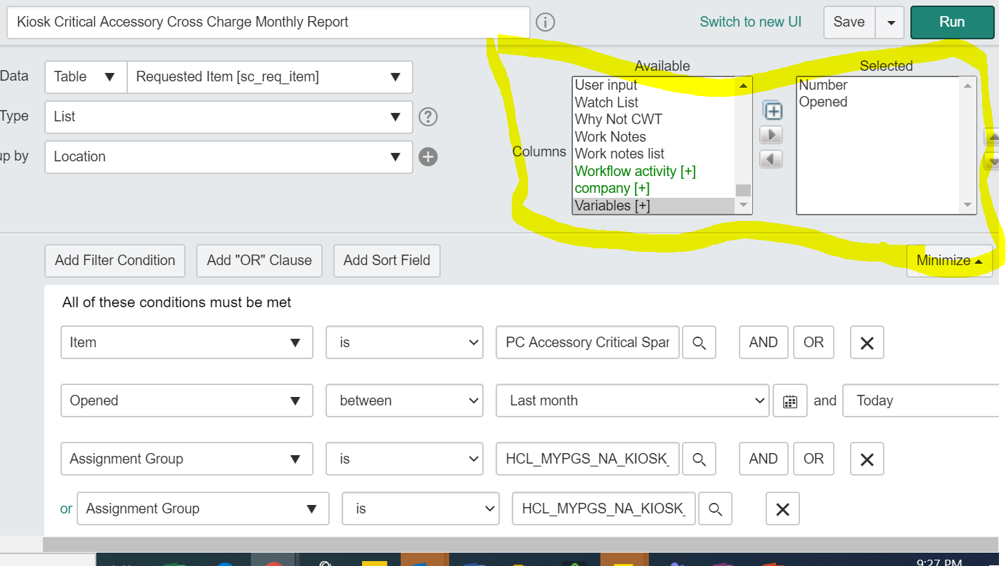
Use “Columns” to Customize View

Slide 34
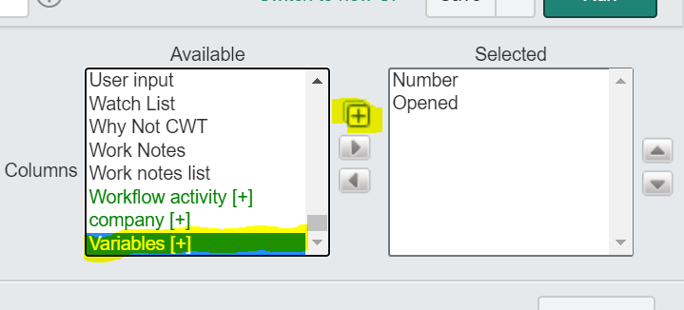
Use “Variables” + the Expansion Button
To add fields specific to the Catalog Request

Slide 35
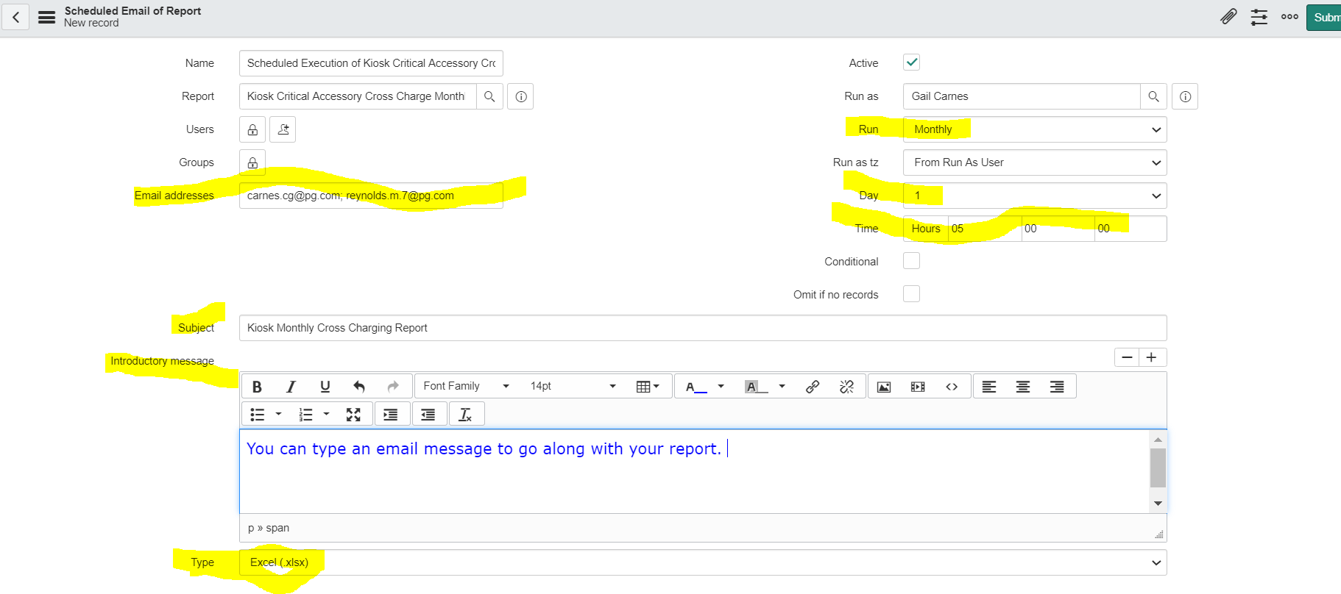
Set the Schedule

